Slide 1
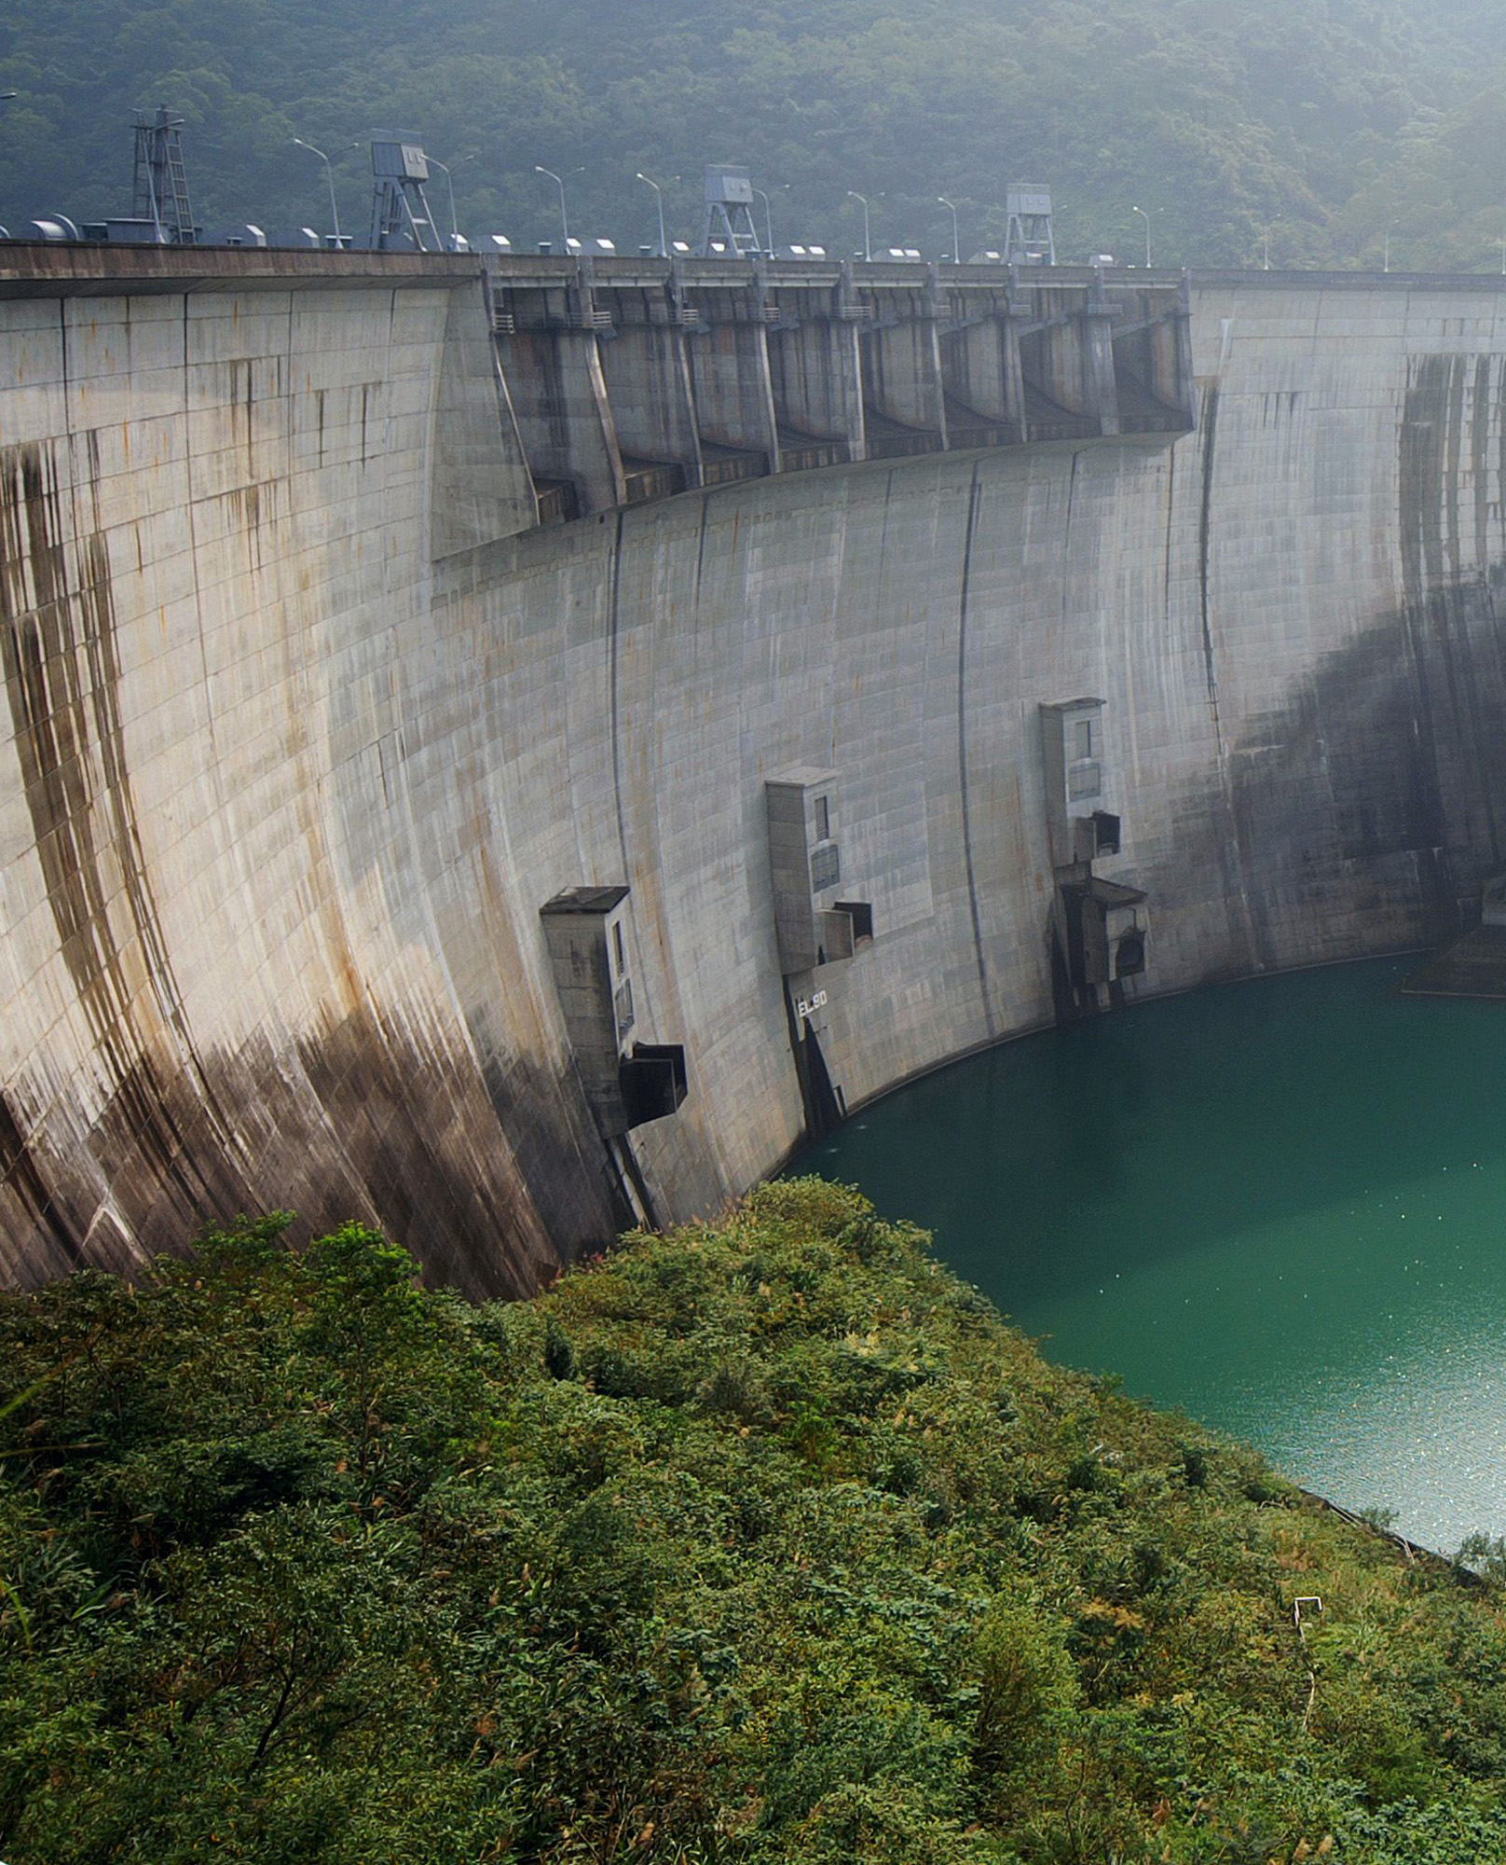
Project 5: Water Management
Seminar ‘Computational Economics‘
Felix Fink
Martin Wicke
Niklas Sayer

Slide 2
Agenda
Motivation
Theory, Implementation
Results
UPDATE!

Slide 3
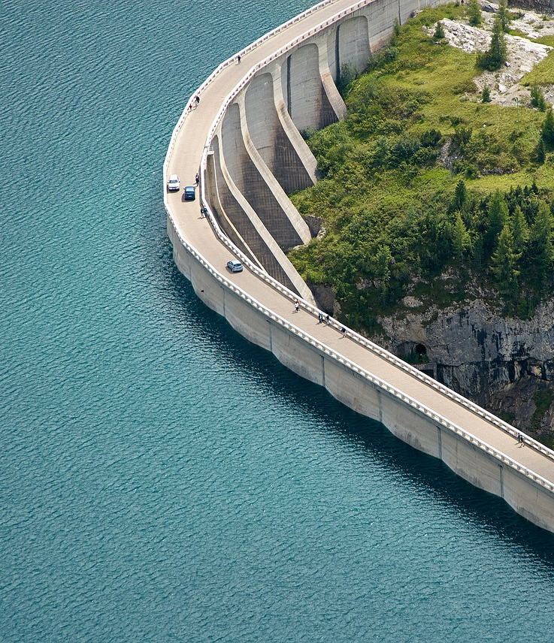
Motivation

Slide 4
Content goes here

Slide 5
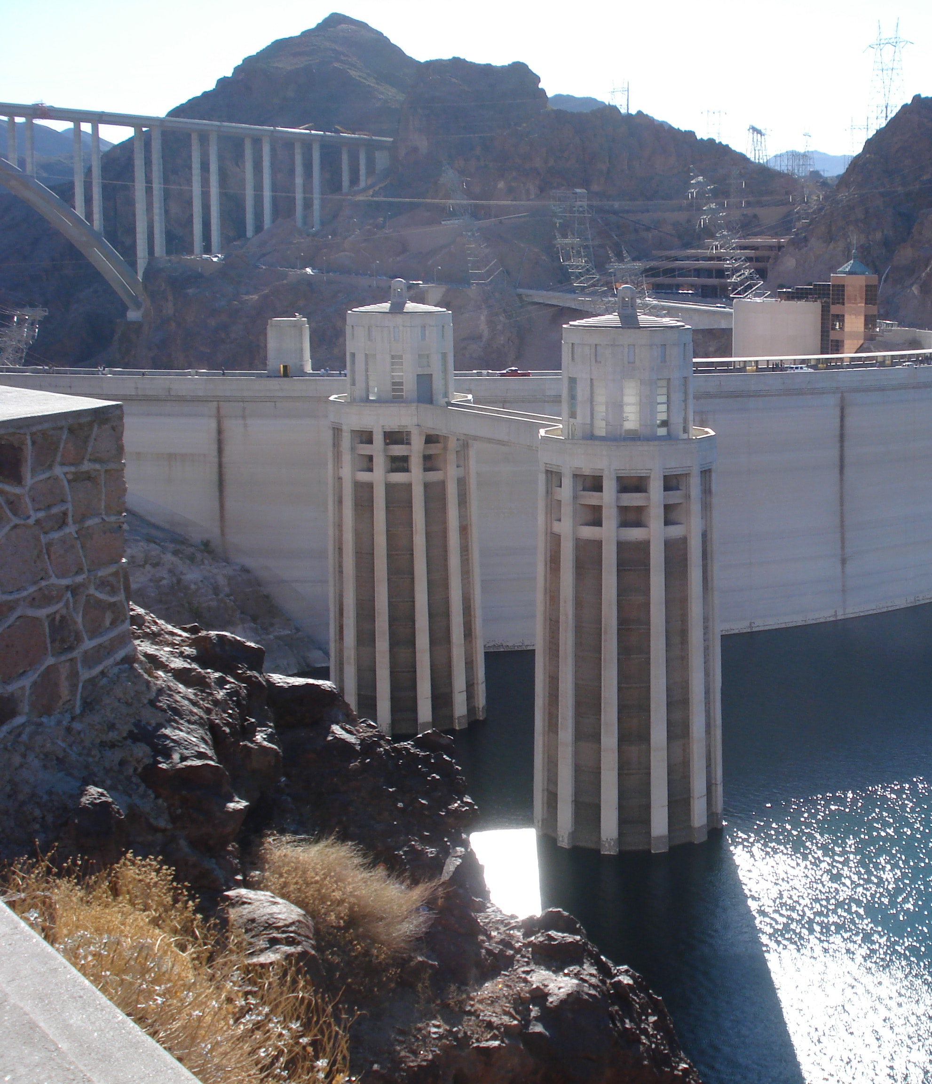
Theory

Slide 6
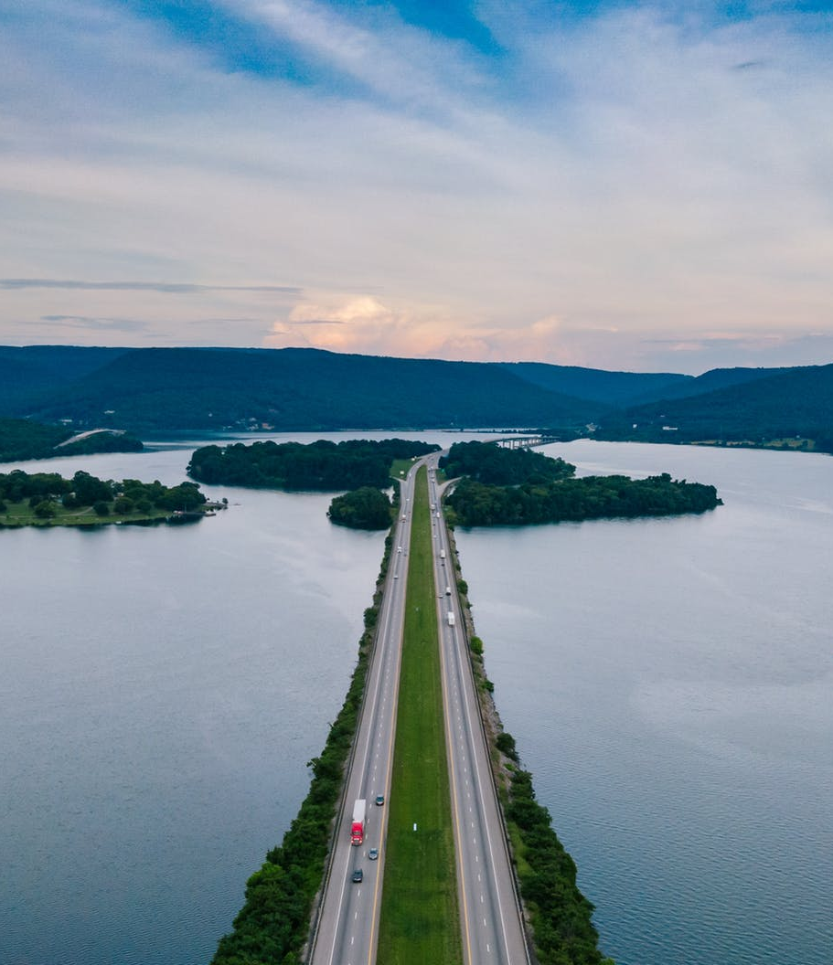
Results

Slide 7
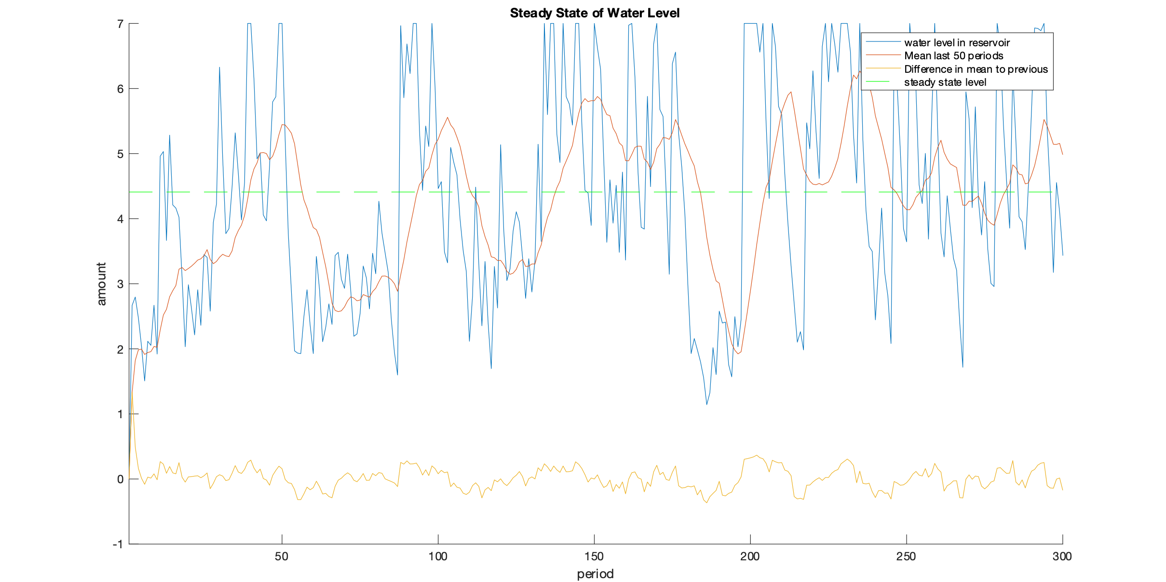
What is the steady state Level of the reservoir?

Slide 8
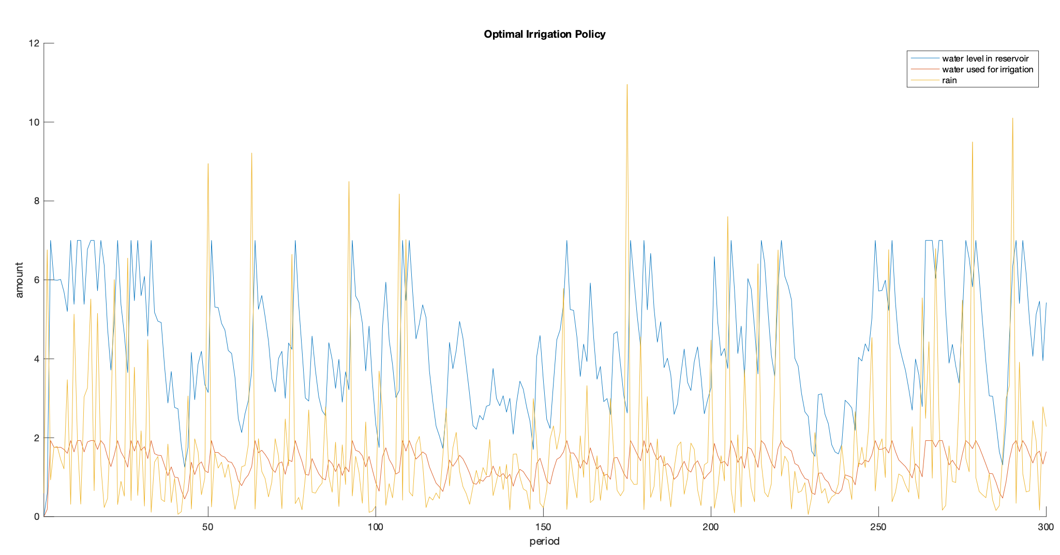
What irrigation policy maximizes the sum of utilities of farmers and recreational users?

Slide 9
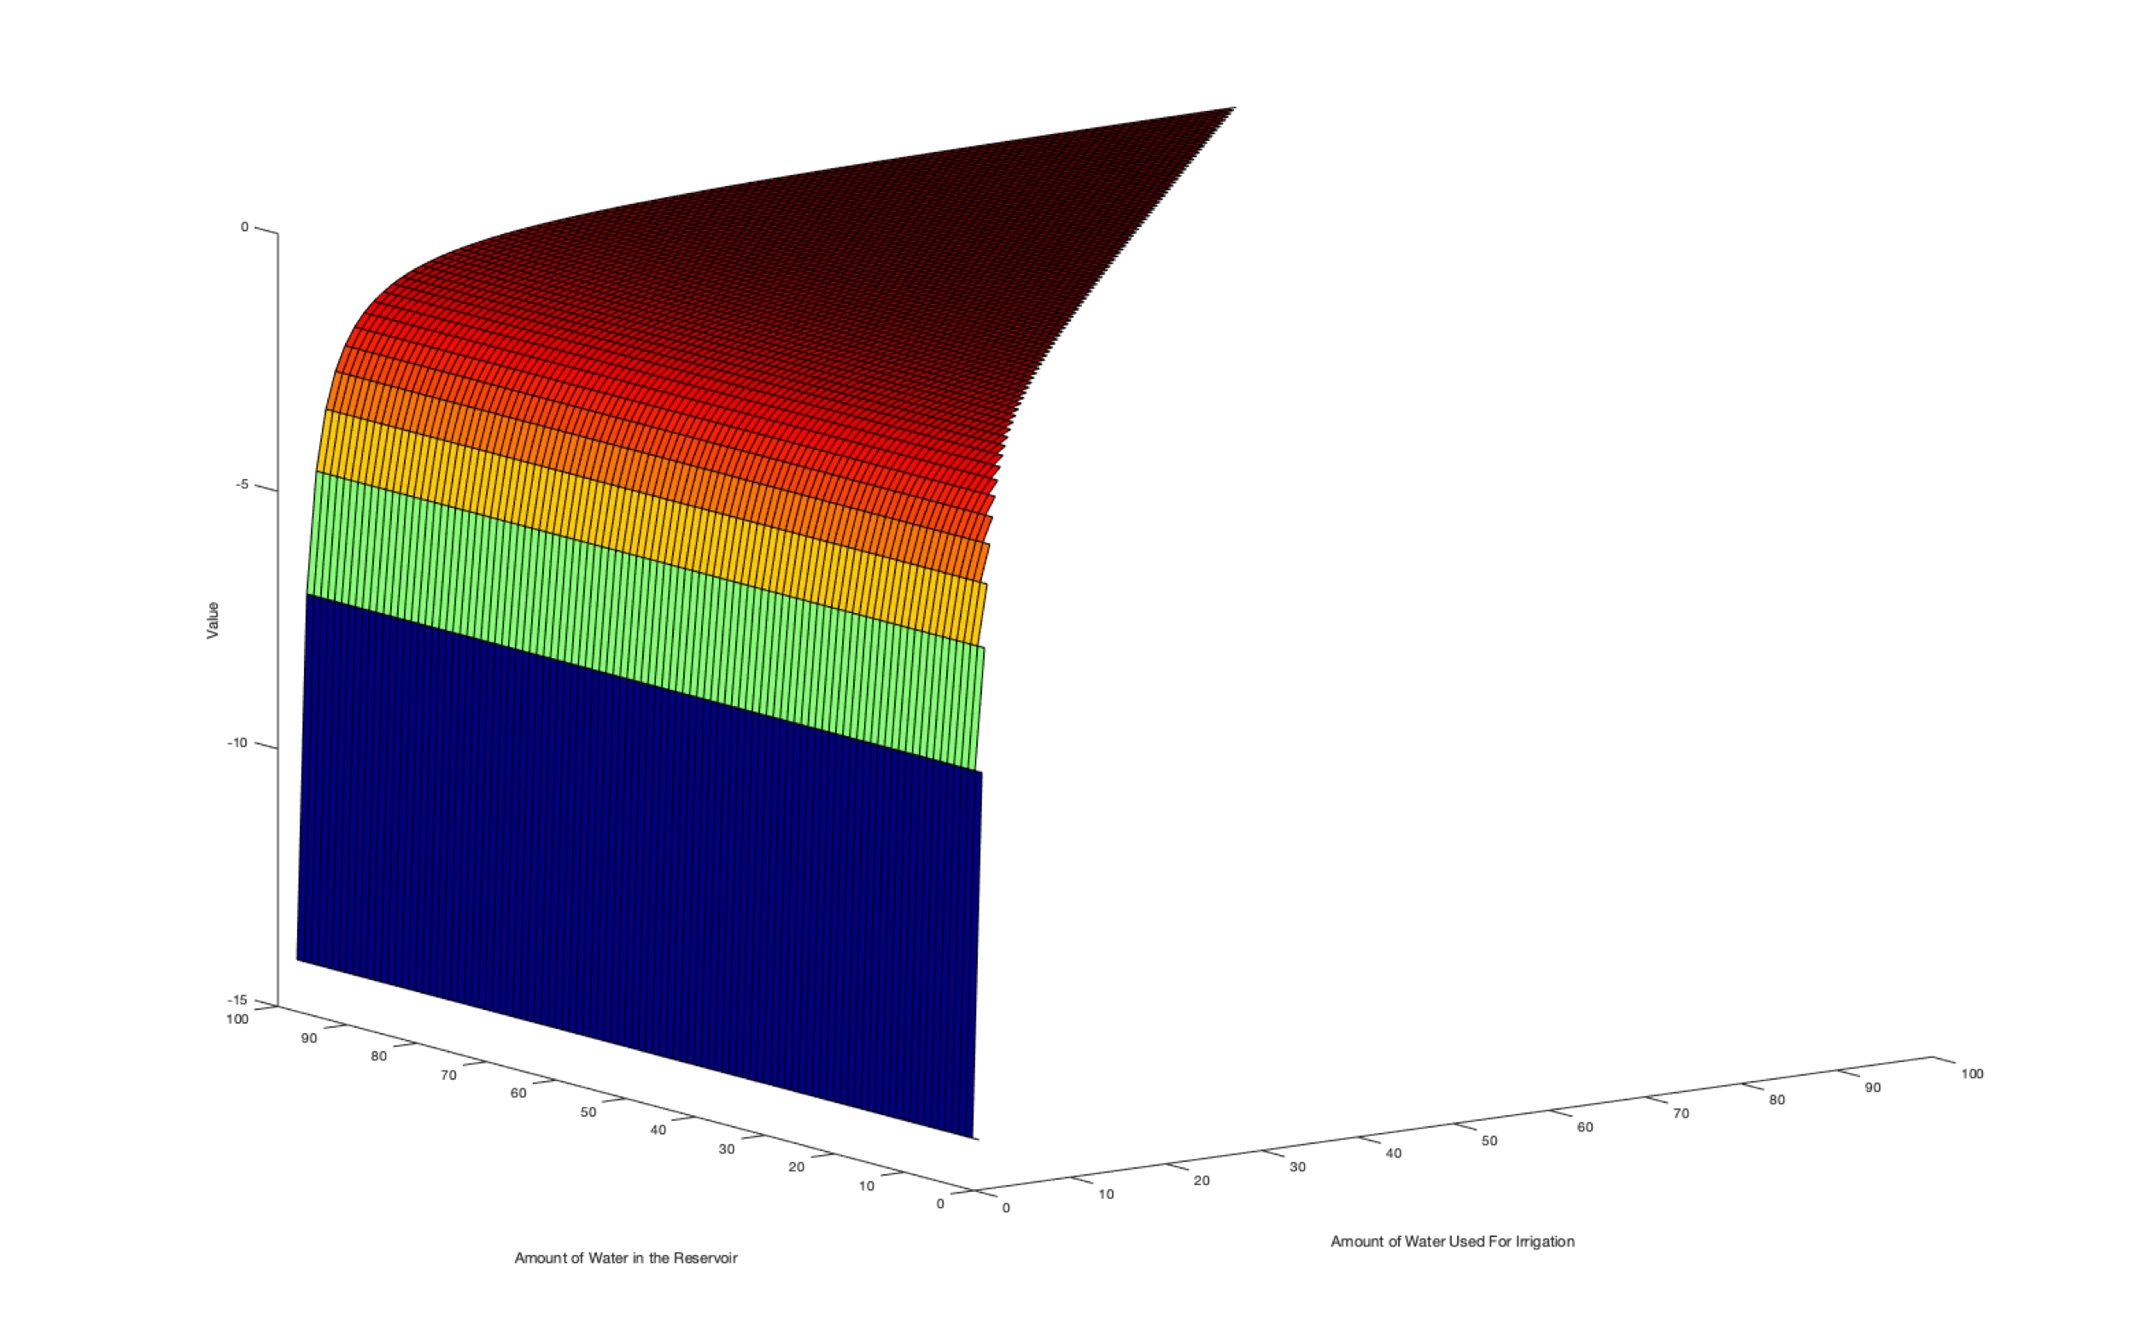
Value Function of Farmers

Slide 10
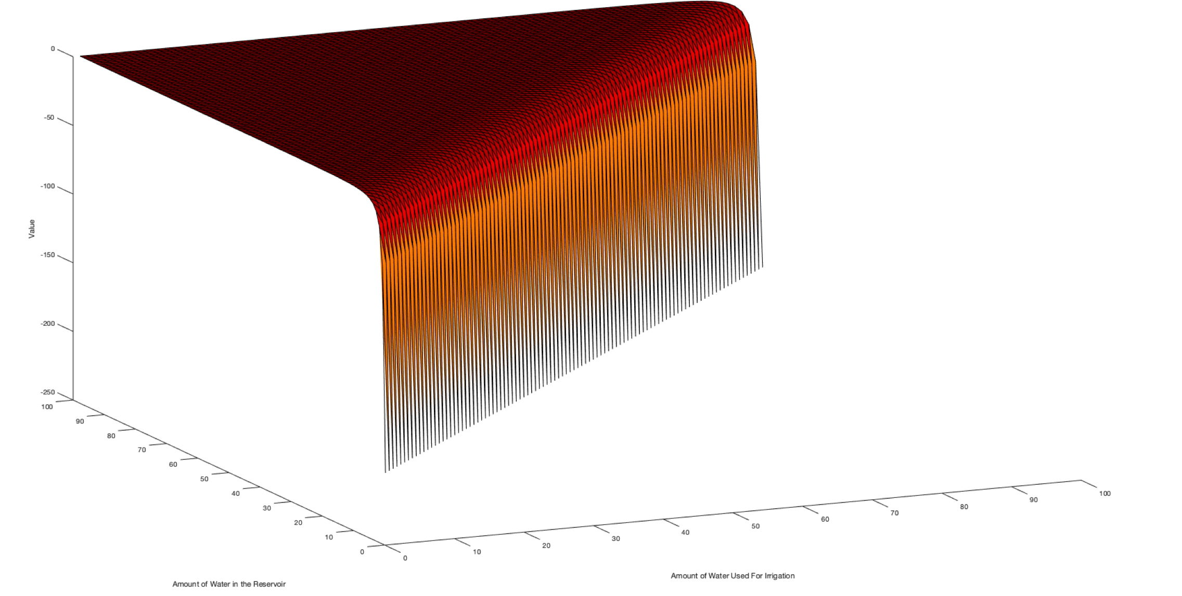
Value Function of Recreational Users

Slide 11
Thank you for your attention!

